Slide 1
Femoral Shaft Fractures
Nyakure

Slide 2
Mechanism
traumatic
high-energy
most common in younger population
often a result of high-speed motor vehicle accidents
low-energy
more common in elderly
often a result of a fall from standing

Slide 3
Associated conditions
orthopaedic
ipsilateral femoral neck fracture
2-6% incidence
often basicervical, vertical, and nondisplaced
missed 19-31% of time
bilateral femur fractures
significant risk of pulmonary complications
increased rate of mortality as compared to unilateral fractures

Slide 4
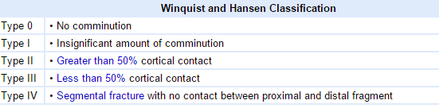
Classification

Slide 5
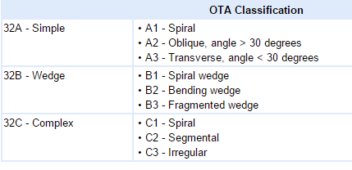
Classification

Slide 6
Clinical presentation
Symptoms
pain in thigh
Physical exam
inspection
tense, swollen thigh
affected leg often shortened
tenderness about thigh
motion
examination for ipsilateral femoral neck fracture often difficult secondary to pain from fracture
neurovascular
must record and document distal neurovascular status

Slide 7
Radiographs
recommended views
AP and lateral views of entire femur
AP and lateral views of ipsilateral hip
important to rule-out coexisting femoral neck fracture
AP and lateral views of ipsilateral knee
CT
indications
may be considered in midshaft femur fractures to rule-out associated femoral neck fracture

Slide 8
Nonoperative
long leg cast
indications
nondisplaced femoral shaft fractures in patients with multiple medical comorbidities
Continuous balanced traction

Slide 9
Operative
IM Nail
Plates and screws
Ex fix

Slide 10
Complications
Malunion
Neurovascular damage: femoral. Pudendal
Non union
Infection
Quadriceps weakness

